Slide 1


CMPE 135: Object-Oriented Analysis and Design September 12 Class Meeting
Department of Computer Engineering San Jose State University Fall 2017 Instructor: Ron Mak
www.cs.sjsu.edu/~mak

Slide 2
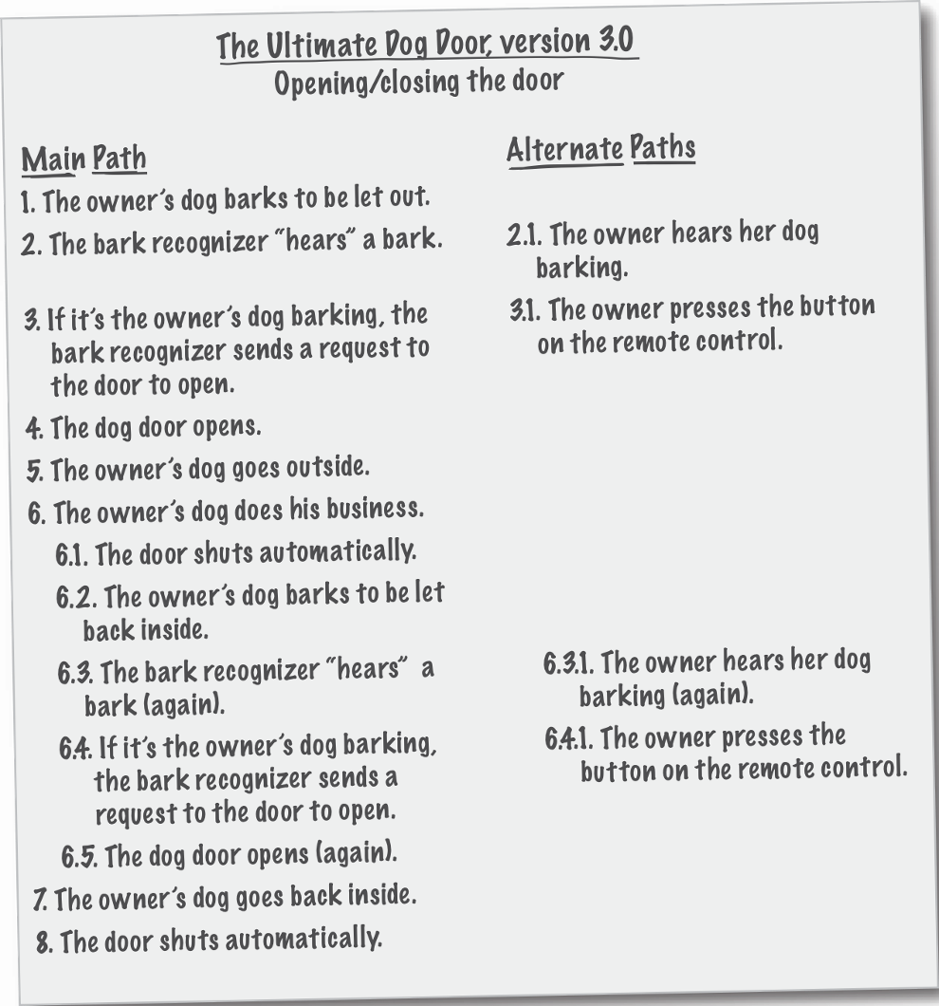
Textual Analysis
Automatic dog door
with bark recognizer:
Use case for opening
and closing the door.
Head First Object-Oriented
Analysis & Design
by Brett D. McLaughlin, et al.
O’Reilly, 2006.

Slide 3
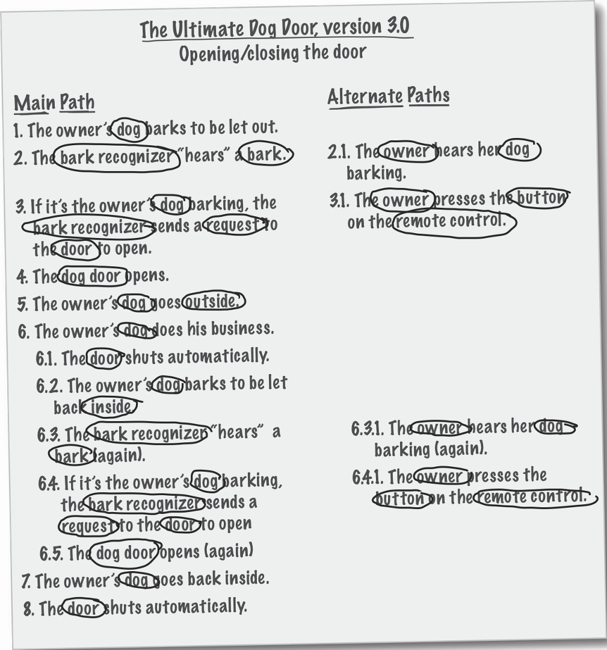
Textual Analysis, cont’d
Nouns
the (owner’s) dog
the owner
the button
bark recognizer
request
inside/outside
dog door
remote control
bark
Head First Object-Oriented
Analysis & Design
by Brett D. McLaughlin, et al.
O’Reilly, 2006.

Slide 4
Textual Analysis, cont’d
Not all words are important in a document.
Some nouns refer to entities that are outside of your system.
Examples: owner, dog
Some nouns refer to things you don’t have to model or create.
Example: request
How will the classes that you’ll create support the behavior that your use cases describe?

Slide 5
Review: Class Responsibilities
Responsibilities correspond to verbs in the use cases.
Each responsibility should be owned by one and only one class.
Common mistakes:
Assigning a responsibility to an inappropriate class.
Assigning too many responsibilities to a class.
Ideally, each class should have a single primary responsibility.

Slide 6
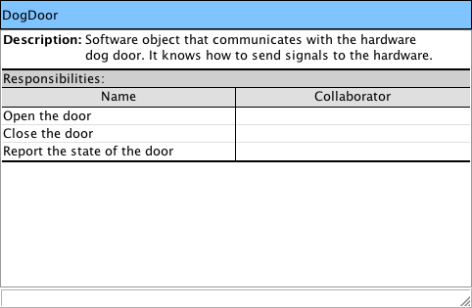
CRC Cards
Class name
Class, Responsibility, Collaboration
Optional
Responsibilities of this class
Classes this class works with to perform its responsibilities
Head First Object-Oriented
Analysis & Design
by Brett D. McLaughlin, et al.
O’Reilly, 2006.

Slide 7
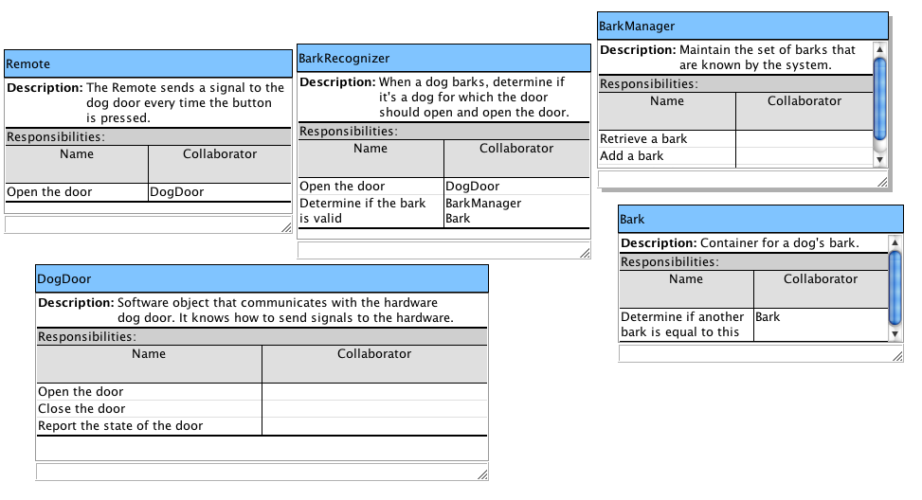
CRC Cards for the Dog Door Use Case
Head First Object-Oriented
Analysis & Design
by Brett D. McLaughlin, et al.
O’Reilly, 2006.

Slide 8
UML Class Diagram: Dependency
Class A uses class B.
This is generally a transient relationship.
Example: A method of class A is passed a parameter of class B.
Example: A method of class A returns a value of class B.
In UML diagrams, draw a dashed line with an open arrowhead from class A to class B.
A
B

Slide 9
UML Class Diagrams: Association
A relationship between class A and class B that lasts as long as class A objects and class B objects live at runtime.
Class A can have an attribute (field) that refers to class B.
Mailbox
msgQueue : Message[ ]

Slide 10
UML Class Diagrams: Association, cont’d
In UML class diagrams, draw a solid line with an open arrowhead from class A to class B.
Label the line with the name of the attribute.
Don’t repeat the attribute inside the class box.
Can also be an aggregation or a composition.
Optionally indicate multiplicity.
Mailbox
msgQueue : Message[ ]
Mailbox
Message
Replace the attribute
with the association.
msgQueue
1
*

Slide 11
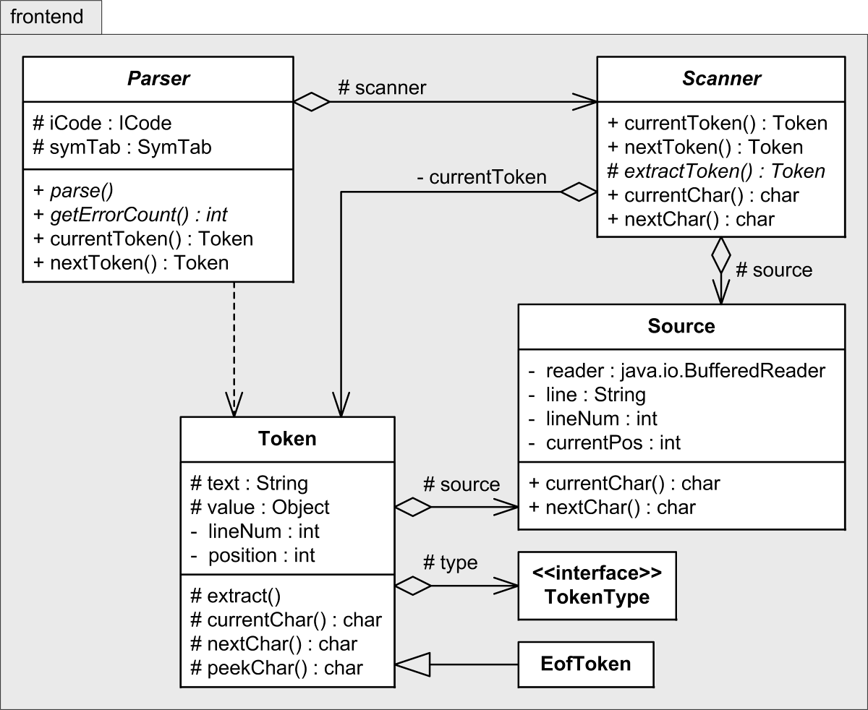
Class Diagram Examples
What’s in the frontend package of a compiler?
UML package diagram
What information can
you learn from these
class diagrams?
Access control
+ public
– private
# protected
~ package
Writing Compilers and Interpreters, 3rd ed.
by Ronald Mak
John Wiley & Sons, 2009.

Slide 12
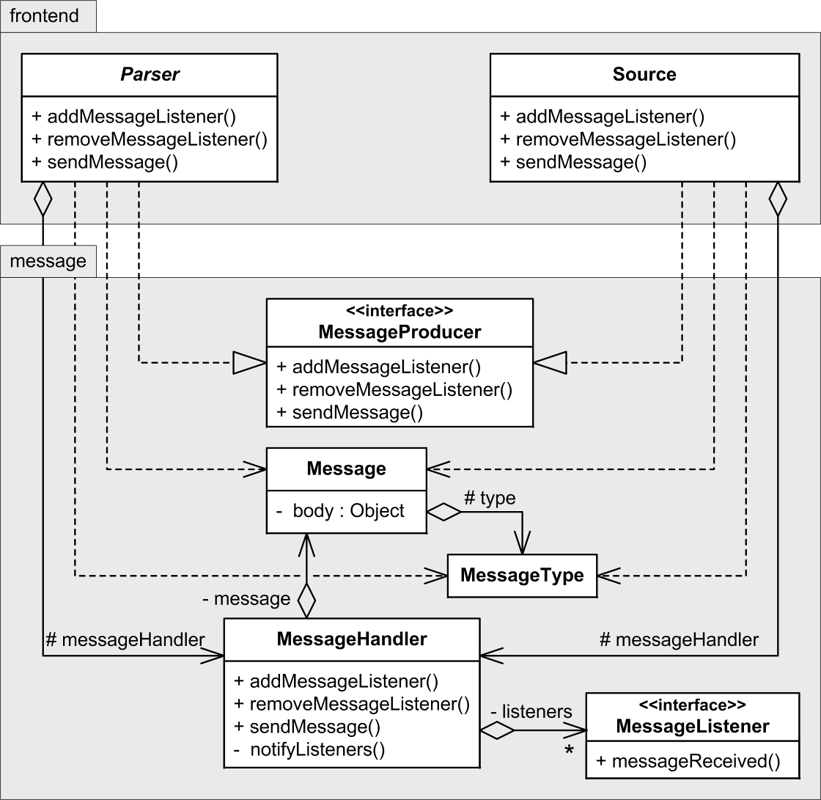
Class Diagram Examples, cont’d
Message handling in the front end of a compiler.
frontend and message packages
Writing Compilers and Interpreters, 3rd ed.
by Ronald Mak
John Wiley & Sons, 2009.

Slide 13
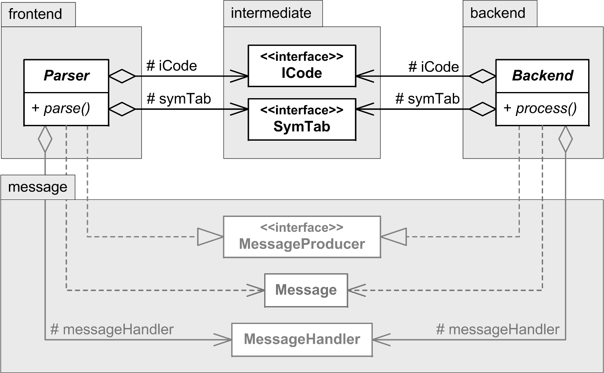
Class Diagram Examples, cont’d
The frontend, intermediate, and backend packages.
Writing Compilers and Interpreters, 3rd ed.
by Ronald Mak
John Wiley & Sons, 2009.

Slide 14
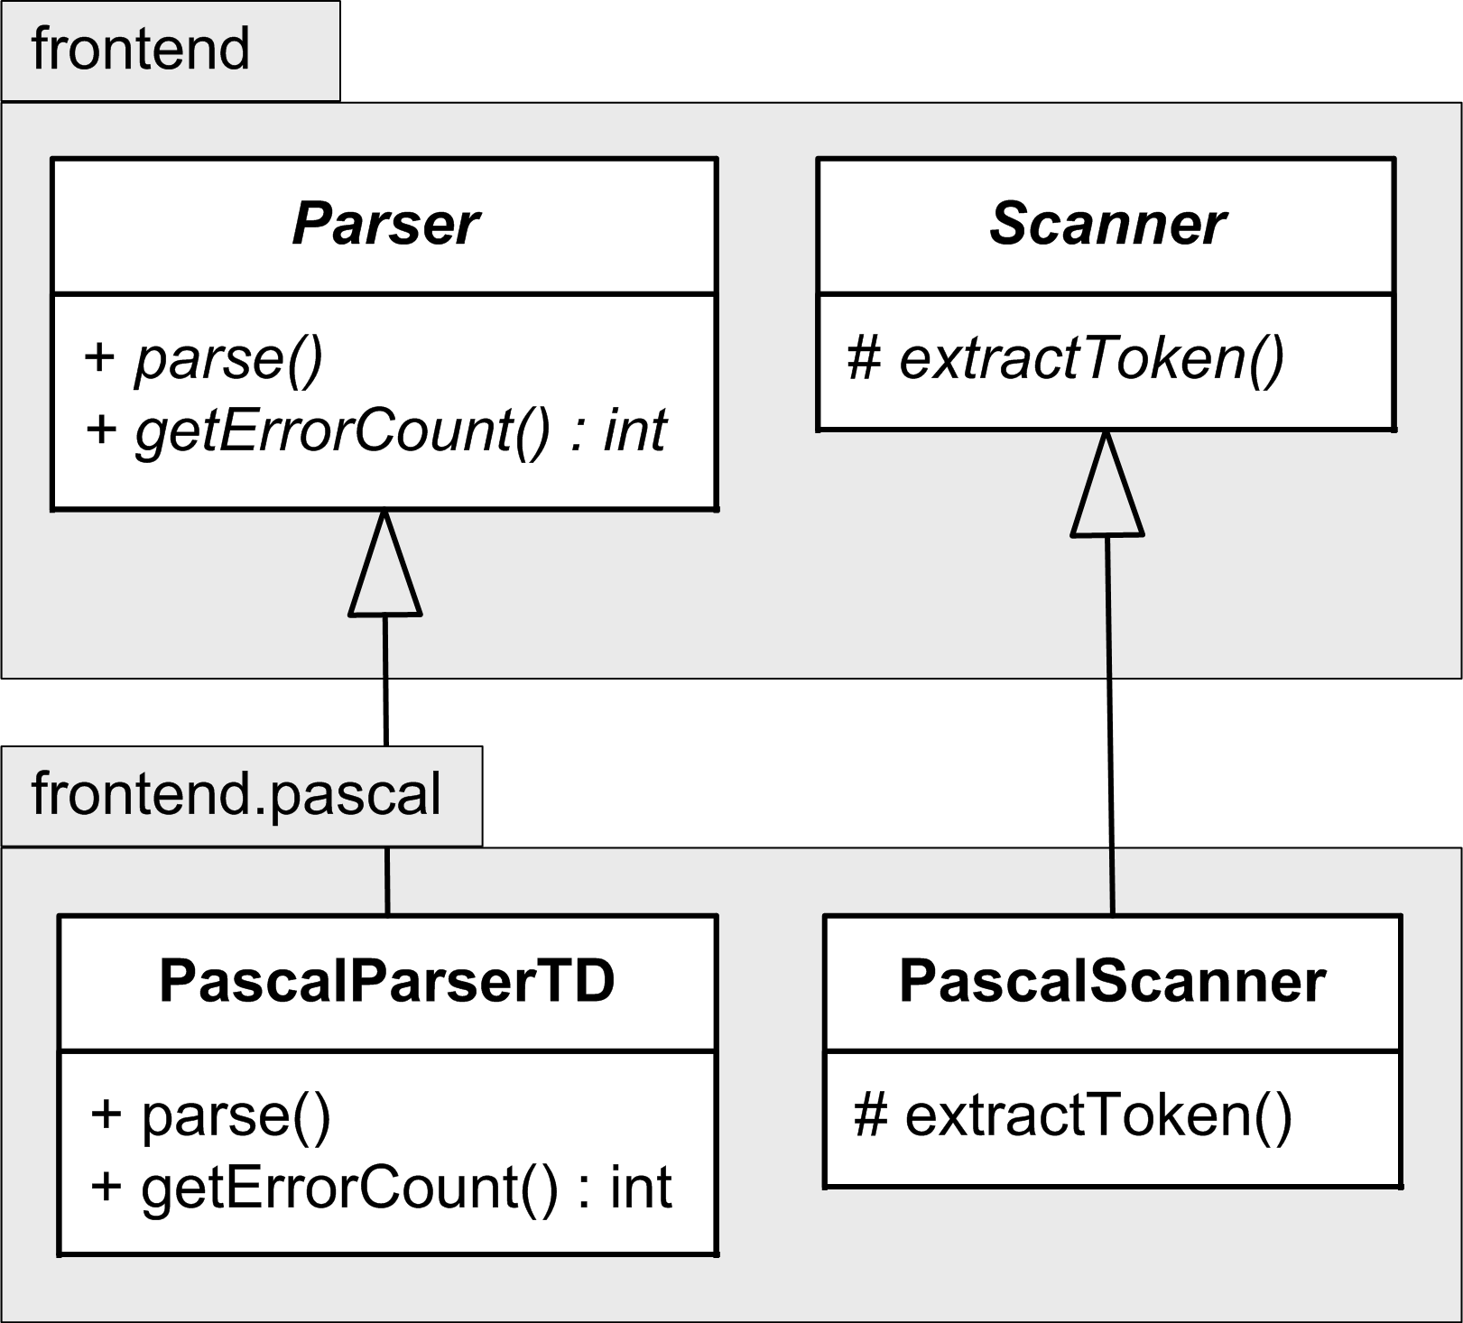
Class Diagram Examples, cont’d
Implement the abstract base classes Parser and Scanner with language-specific subclasses.
Writing Compilers and Interpreters, 3rd ed.
by Ronald Mak
John Wiley & Sons, 2009.

Slide 15
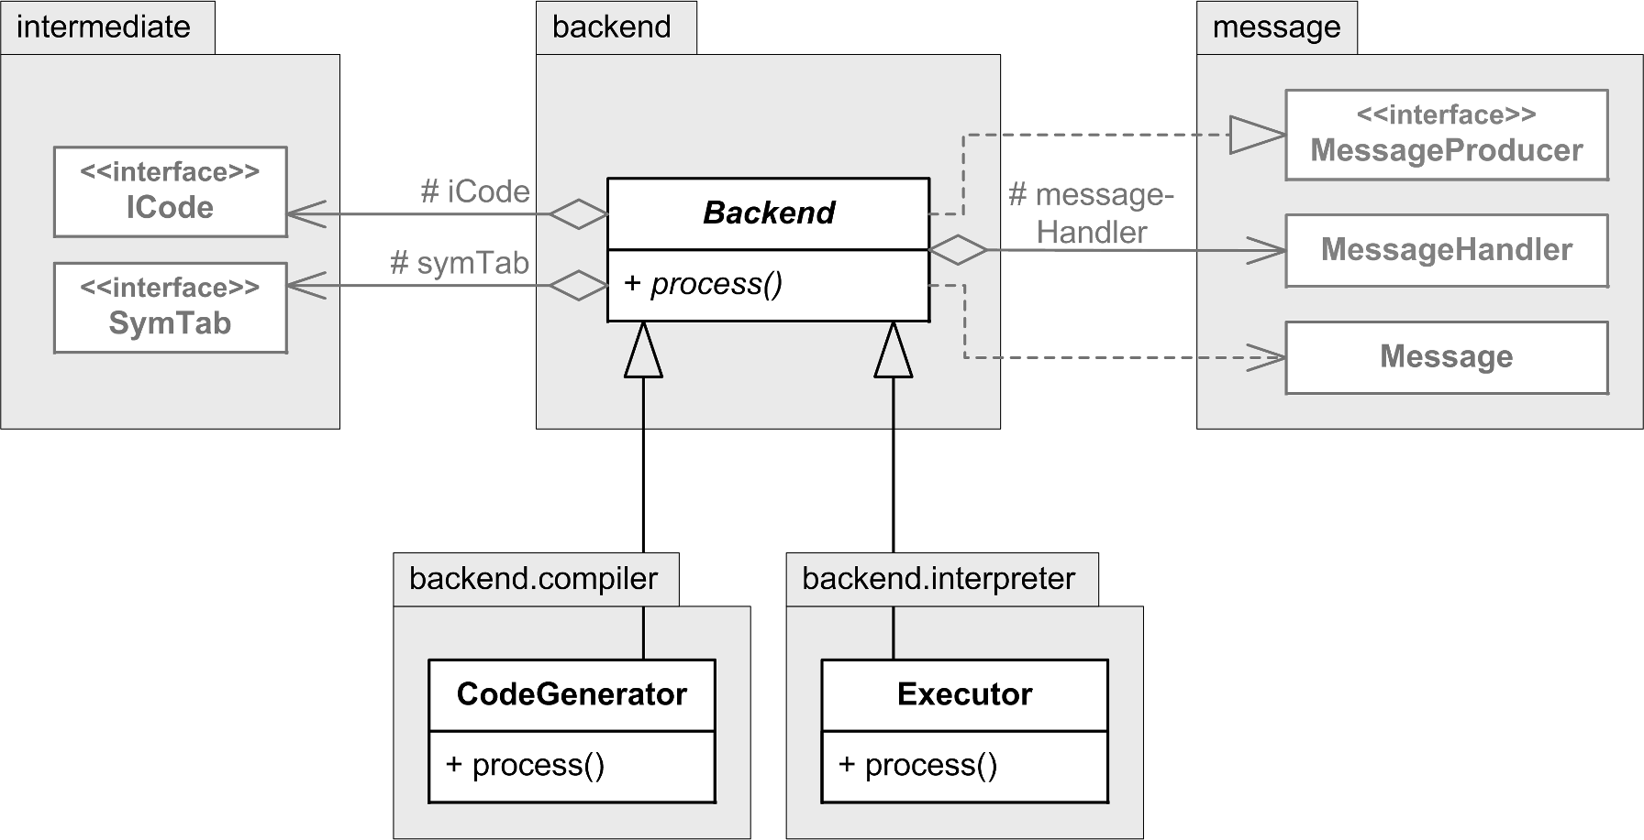
Class Diagram Examples, cont’d
The back end can be a CodeGenerator or an Executor.
Writing Compilers and Interpreters, 3rd ed.
by Ronald Mak
John Wiley & Sons, 2009.

Slide 16
UML State Diagram
A state diagram shows the behavior of classes in response to external stimuli.
AKA statechart diagram
A state diagram describes the behavior of a single object in response to a series of events in a system.
At run time, the state of an object is characterized by the values of its fields.
Different states can cause different behaviors.

Slide 17
Initial and Final States
A filled circle represents the object’s initial state.
A filled circle nested inside another circle represents the object’s final state.

Slide 18
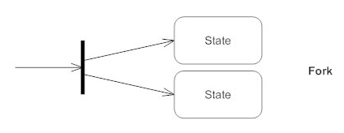
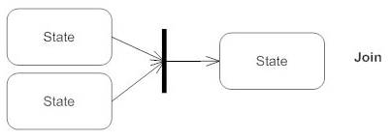
Control Splits and Synchronization
A short heavy bar called a fork represents a control split, with several transitions leaving it:
A short heavy bar called a join represents a synchronization of control, where several concurrent transitions reduce back to one.
https://www.smartdraw.com/state-diagram/

Slide 19
UML State Diagram Example #1

Slide 20
UML State Diagram Example #2

Slide 21
UML State Diagram Example #3

Slide 22
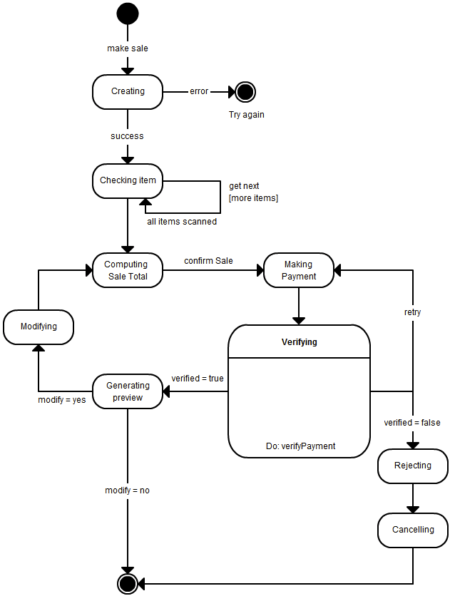
UML State Diagram Example #4

Slide 23
UML State Diagram Example #5

Slide 24
Design Goals for Good Classes
Reliable
Robust
Flexible
Coherent
Easy to use (by other programmers)
Safe to use
Easy to test
Easy to extend
Easy to maintain

Slide 25
A Proposed C++ Date Class
Enable programs to manipulate dates.
Example:
// Construct a Date object to represent
// the current date and time.
Date *now = new Date();
// Print out the date such as // Mon Feb 20 16:34:10 PST 2012
cout << now->date_string() << endl;

Slide 26
Methods of the Date Class
bool after(Date *other) | Test if this date is after the specified date
bool before(Date *other) | Test if this date is before the specified date
int compare_to(Date *other) | Tell which date came before the other
long get_time() | Return milliseconds since the epoch (1970-01-01 00:00:00 GMT)
void set_time(long n) | Set the date to the given number of milliseconds since the epoch
after() and before() are convenience member functions.
Not necessary, but nice to have.
A date value is represented as a scalar value.

Slide 27
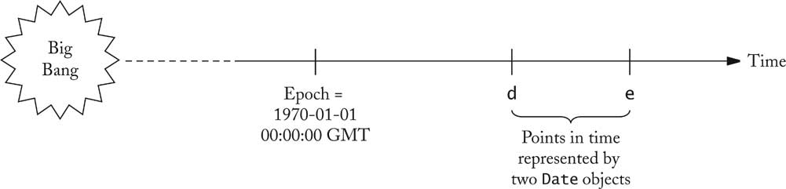
Points in Time
Object-Oriented Design & Patterns, 2nd ed.
by Cay Horstmann
John Wiley & Sons, 2006.

Slide 28
The date_string Function
The date_string() member function of the Date class is primarily for debugging purposes.
It would be awkward to have to parse the string that it returns.

Slide 29
What about Month, Day, and Year?
The Date class can delegate to a Calendar class the task of converting the number of milliseconds since the epoch to year, month, day, hour, minute, and second fields.
Example Calendar classes:
GregorianCalendar
LunarCalendar
MayanCalendar
etc.

Slide 30
Calendar Classes
The specific Calendar class can be a changing part of an application’s design.
Make Calendar an abstract base class for the GregorianCalendar class and any other calendar classes you may write:
Date
Calendar
Gregorian
Calendar
Lunar
Calendar

Slide 31
Some Functions of the Calendar Class
int get(int field) | Get a field value, where field is a Calendar class constant such as YEAR, MONTH, DATE, HOUR, MINUTE, SECOND.
void set(int field, int value) | Set a date field.
void add(int field, int increment) | Add to a field.
Date get_time() | Convert to a Date value.
void set_time(Date *d) | Convert from a Date value.

Slide 32
What’s Wrong with this Code?
GregorianCalendar *g = new GregorianCalendar();
g->set(Calendar::YEAR, 2013);
g->set(Calendar::MONTH, Calendar::SEPTEMBER);
g->set(Calendar::DATE, 10);
This code is permanently bound to the Gregorian calendar.
What if you decide later to switch to the lunar calendar?

Slide 33
What’s Wrong with this Code? cont’d
Instead, code to the interface.
In this case, the interface is the abstract Calendar class.
Calendar *cal = CalendarFactory.create(type);
cal->set(Calendar::YEAR, 2013);
cal->set(Calendar::MONTH, Calendar::SEPTEMBER);
cal->set(Calendar::DATE, 10);

Slide 34
Factory Design Pattern
Calendar *cal = CalendarFactory.create(type);
cal->set(Calendar::YEAR, 2013);
cal->set(Calendar::MONTH, Calendar::SEPTEMBER);
cal->set(Calendar::DATE, 10);
This code uses the factory method design pattern.
public class CalendarFactory
{
public static Calendar *create(int type)
{
if (type == GREGORIAN) {
return new GregorianCalendar();
}
else if (type == LUNAR) {
return new LunarCalendar();
}
...
}
}

Slide 35
Design a Day Class
Answer questions such as
How many days between now and the end of the year?
What day is 100 days from now?
A Day object represents a particular day.
Some limitations
Uses the Gregorian calendar only
No time of day
No time zone

Slide 36
Functions of the Day Class
Day(int year, int month, int date) | Constructor.
int days_from(Day *d) | Return the number of days between day d and the day represented by the object. The return value can be negative if day d comes before, or 0 if it’s the same day. Example: int n = today->days_from(birthday);
Day add_days(int count) | Return the day that is count days from the day represented by the object. The count value can be negative. Example: Day *later = holiday->add_days(5);
int get_year() int get_month() int get_date() | Getter methods.

Slide 37
The Day Class
d->add_days(n)->days_from(d) equals n
Add 3 (n) days to September 12 (d) to get September 15, which is 3 days from September 12.
(d + n) - d == n
d1->add_days(d2->days_from(d1)) equals d2
September 15 (d2) is 3 days from September 12 (d1). Add those 3 days to September 12 to get back to September 15.
d1 + (d2 - d1) == d2

Slide 38
The Day Class
Methods days_from() and add_days() are not trivial!
April, June, September, November have 30 days.
February has 28 days, except in leap years it has 29 days.
All other months have 31 days.
Leap years are divisible by 4, except after 1582, years divisible by 100 but not 400 are not leap years.
There is no year 0; year 1 is preceded by year -1.
In the switchover to the Gregorian calendar, ten days were dropped: October 15, 1582 is preceded by October 4.

